Slide 1
(Universal voices)
virtual ASL classroom
D
Mariam Al-Omari, Micah Jessicah Hein and Maithaa Al Saiqal
E

Slide 2
Table of content
01.
02.
03.
04.
05.
06.
Background
Gameplay Demonstration
Contribution
Project Development
Results and code
Future work and conclusion

Slide 3
Introduction
H
I
Our project is designed to address the critical need for effective American Sign Language (ASL) education.
K

Slide 4
466,000,000
Problem
W
The World Health Organization estimates that over
people have disabling hearing loss, with a significant portion requiring accessible means of communication.
Z

Slide 5
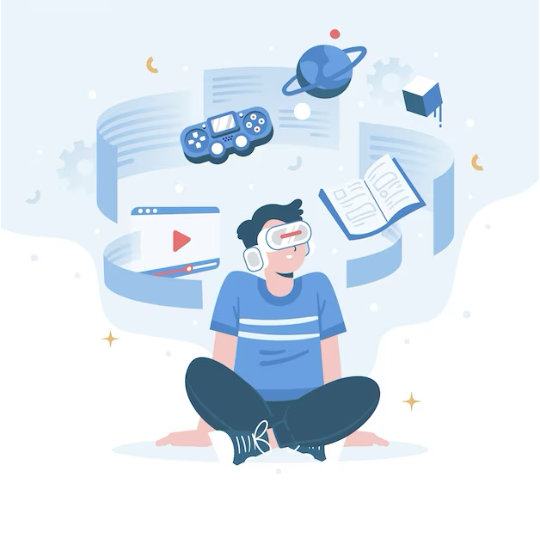
Solution
Provide a platform to teach sign language in an immersive learning environment to foster effective communication between the hard of hearing and the hearing.

Slide 6
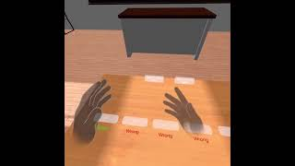
Game demonstration

Slide 7
Contribution
Video Recordings
Video Clippings
Classroom setup/ code
Micah & Maithaa
Maithaa
Mariam & Micah
Trip set up/code
Quiz/Learn topic buttons / Code
Floating/smooth walk code
Mariam & Micah
Mariam & Micah
Mariam
Video code/clips
Report/ Presentation
Micah
Maithaa & Micah & Mariam

Slide 8
L
Project development
Started with using a classroom asset that Pi provided for us with, we imported additional needed assets from unity as well.
To create our immersive learning experience, we borrowed a tripod and recorded high quality videos of ourselves performing ASL.
Those videos projected onto a preexisting blackboard (using a plane) in the classroom, emphasizing our classroom atmosphere.

Slide 9
Project development continued
We included a mirror that we created from scratch using a plane and a camera to reflect back the user’s hands, allowing our user to see their hands both from the front and back.
we included a special feature of a trip, which takes our player outside the classroom to a new scene/asset: a farmers market where the player can take a quiz.
We had to convert all our videos from .mp4
F

Slide 10
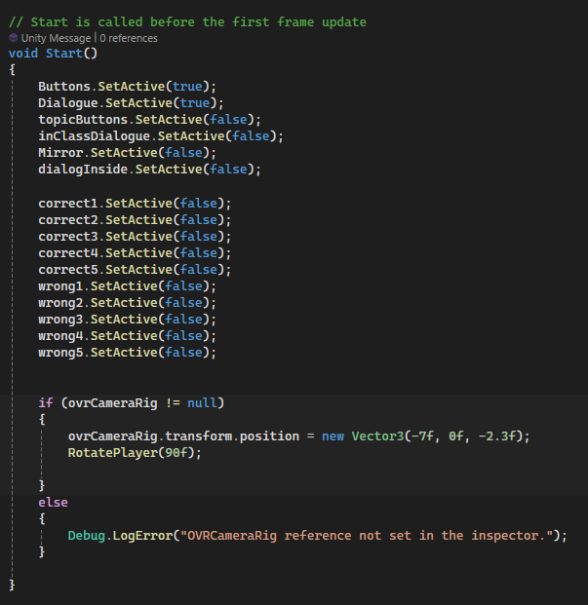
GameUIManager
Results (code)
Notes:
Maithaa

Slide 11
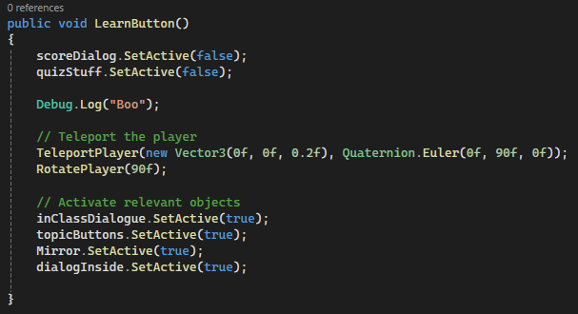
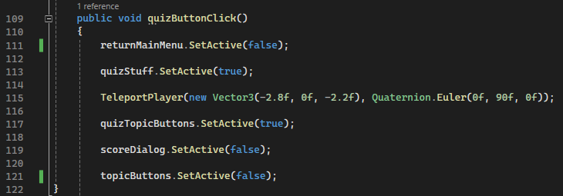
Notes:
Maithaa
Connect the function to the appropriate button in the inspector of each button

Slide 12
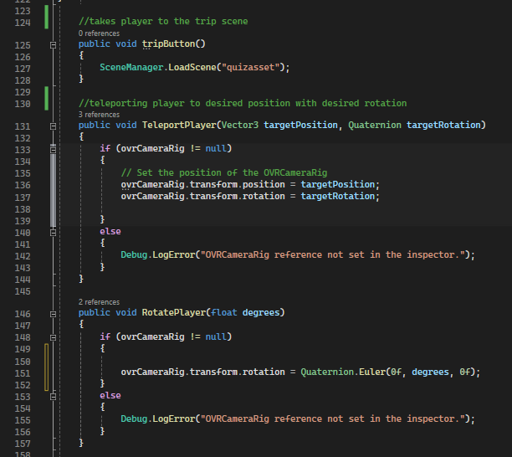
Notes:
Maithaa/Micah

Slide 13
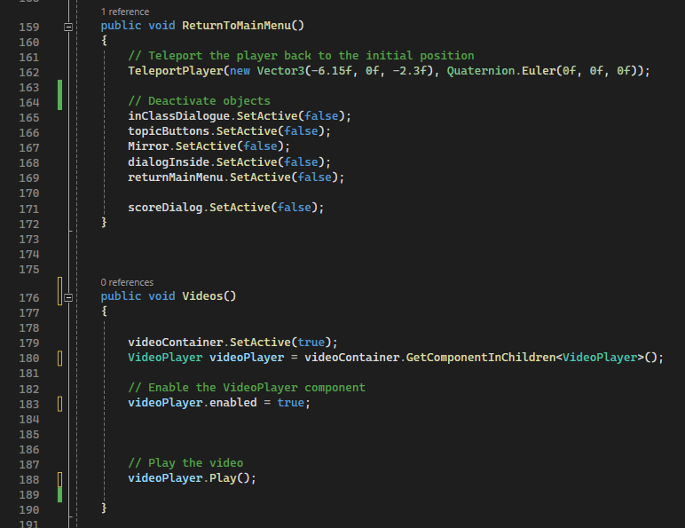
Notes:
Micah

Slide 14
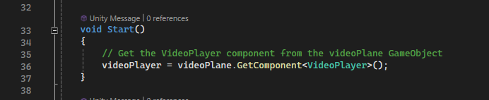
Learn Topic Button
Notes:
Micah
Script for when the learn topic button is pressed

Slide 15
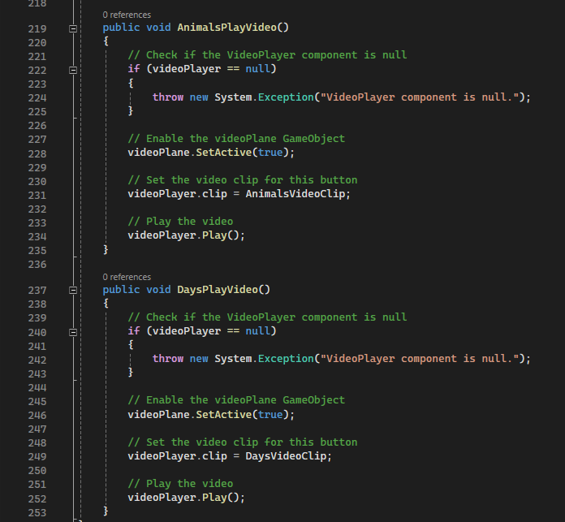
Notes:
Micah

Slide 16
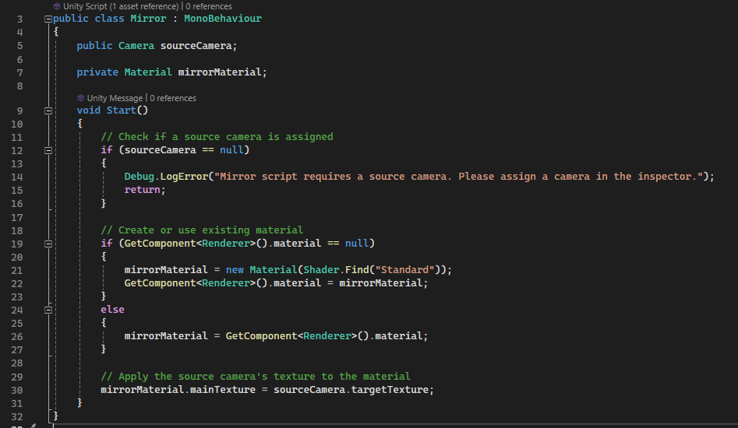
Mirror
Notes:
Mariam

Slide 17
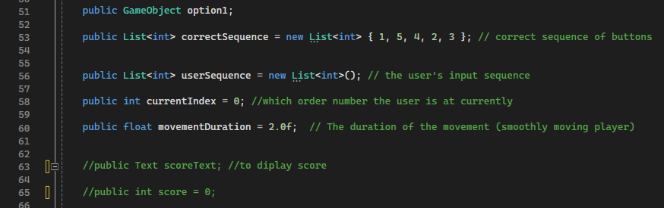
Alphabet Quiz
Notes:
Mariam
Example for when a topic button is pressed.

Slide 18
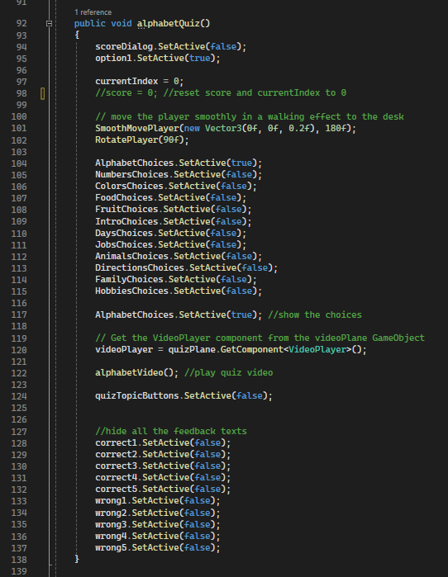
Notes:
Mariam

Slide 19
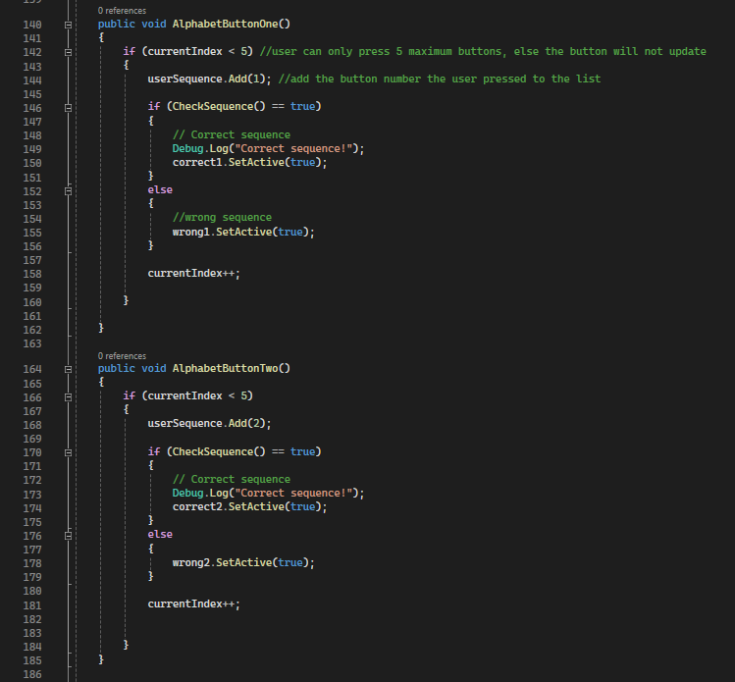
Notes:
Mariam

Slide 20
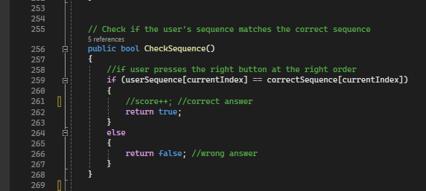
Notes:
Micah

Slide 21
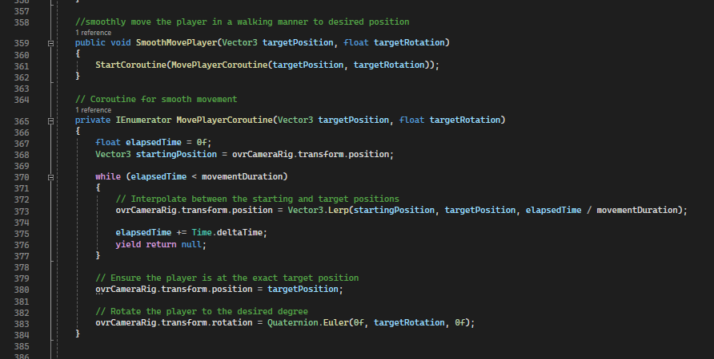
Notes:
Mariam

Slide 22
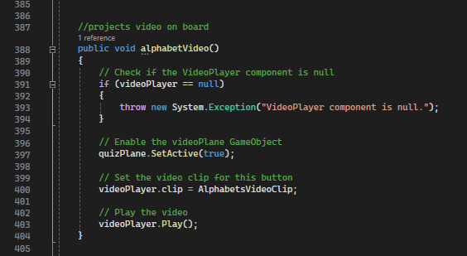
Notes:
Micah

Slide 23
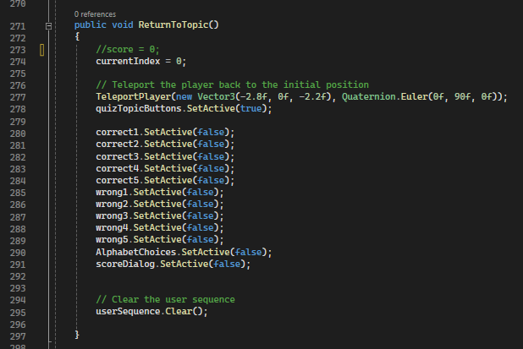
Notes:
Mariam

Slide 24
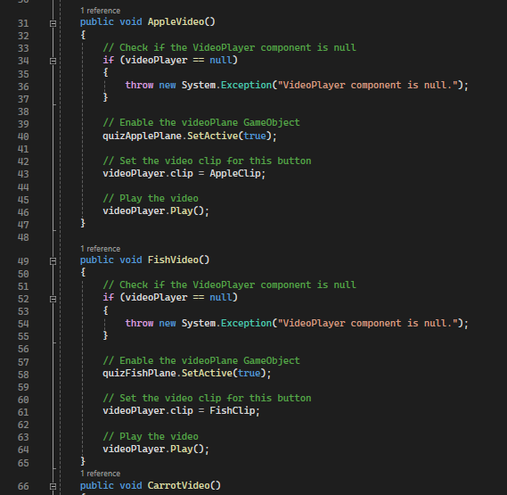
Trip
Notes:
Micah

Slide 25
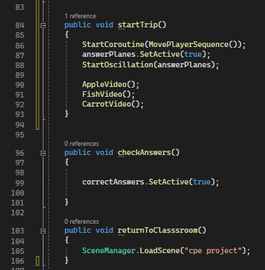
Notes:
Micah

Slide 26
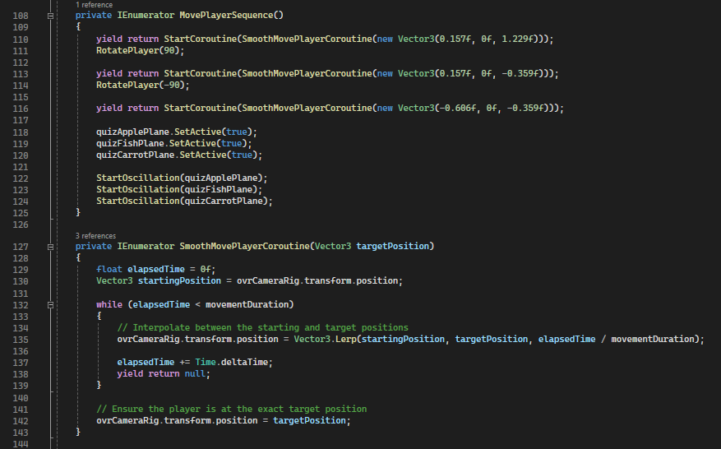
Notes:
Mariam

Slide 27

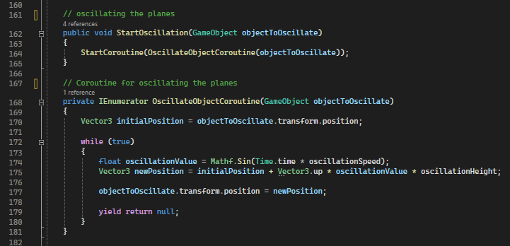
Notes:
Mariam

Slide 28
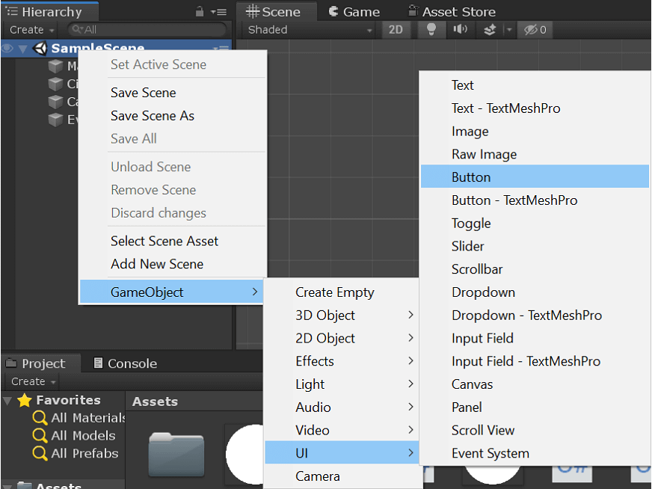

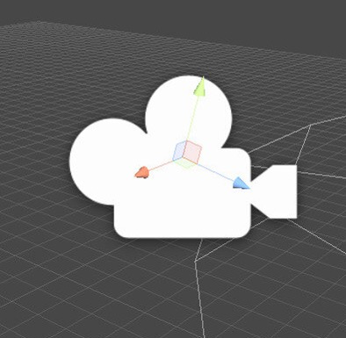
Evaluation
(setbacks)
P
Buttons
Asset selection
Camera
M

Slide 29
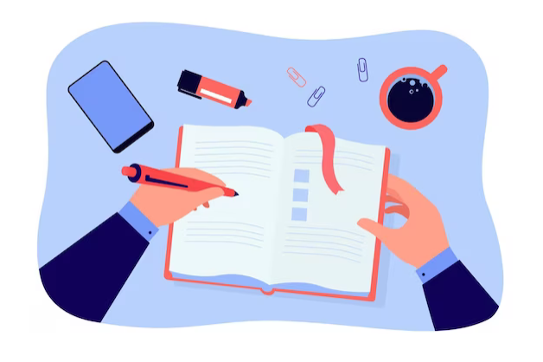
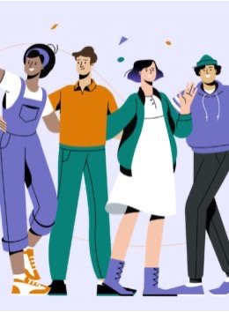
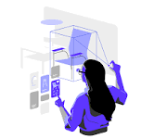
Future improvements
Adding gravity
Expanding our word bank
Having a user profile (tracking user progress)
Implementing our project in AR

Slide 30
Conclusions:
01.
02.
03.
04.
05.
06.
We learned how to utilize a new software
Were introduced to c sharp
Improved our time management
We learned about ASL
Learned how to divide work
Developed problem solving skills

Slide 31
Thank you!

